Slide 1
Government / Public Policy Context
HDO Organizational Boundary
HDO
Policies
Order Governance Boundary
Order Definition
Order Construction
PoC Process Boundary
Order Execution
ICS Boundary
PCA MSIS
ICS Component Boundary
Control
Feedback
Patient

Slide 2
2800-1
Compliance to architecture specification requirements
Compliance
to Requirements to map to Safety, Security, and Essential Performance Objectives
Implementation
Compliance
ICE Architecture Platform and Service Component Implementation
2800-0
2800-1-1
Uses
Compliance to architecture and development requirements
Compliance
To Clinical and safety Objectives
Implementation
Compliance
2800-2
2800-2-1
2800-3-1-1
Mock Vendor
Submission
Requirements on how to fill in the gaps (document/disclosures) in “templates” for an ICE-based PCA Monitoring ICS
Requirements on what to account for in Risk Management
Requirements on what to test and how to document results
Requirements on structure/content of final assurance case
App
System/App Requirements Document
Risk Management Results
Verification Results
Assurance Case

Slide 3
Boundary Definition Activities
Delineate Boundary
Identify inputs/outputs (directional modes)
Identify Actor Categories (human/machine) on either side of interface
From Component’s point of view
Inputs (flow from context to component)
specify assumptions A_{Cmp} on inputs (requirements on context)
Outputs (flow from component to context)
specify guarantees G_{Cmp} on outputs (requirements on component)
A_{cmp} and G_{Cmp} form the Component’s interface contract
From Context’s (Client’s) point of view
Call/Push (flow from context to component)
Specify guarantees G_{Cxt} on flows to component (requirements on context)
Return/Pull (flow from component to context)
Specify assumptions A_{Cxt} on flows from component (requirements on component)

Slide 4
Assembly/Integration Assurance
Context
Safety case will include the following assurance steps for parameters on which SSEP depends
G_{Cxt} complies with A_{Cmp}
G_{Cmp} complies with A_{Cxt}
SSEPOs will state the “vocabulary” or categories of 2800-relevant properties mentioned in A_{X}, G_{X}
Testing/Verification activities will provide evidence of the compliance steps
G_{Cxt}
Component
A_{Cmp}
G_{Cmp}
A_{Cxt}

Slide 5
Implementation Compliance Assurance
Safety case will include the following assurance steps for parameters on which SSEP depends
The component implementation which includes internal components providing properties P_{i} complies with its interface contract (A_{cmp},G_{Cmp})
SSEPOs will state the “vocabulary” or categories of 2800-relevant properties mentioned in A_{X}, G_{X}
Testing/Verification activities will provide evidence of the compliance steps
Note that the ICS (System) interface is a special instance of the component interface
Component
Implementation
Component
Interface
A_{Cmp}
P₁
P₂
P₃
G_{Cmp}
Where do we get, e.g., the system level A,G related to safety? Ans: aim to ensure safety (avoid hazards) related to controlled process (patient).

Slide 6
Generic Control Loop:
Controller
Controller Setting
Model of Controlled Process
Actuator
Sensor
Operator
Actuation
Via SUI App Control Panel
Controlled Process
Feedback, sensed properties
Control Actions
Key concept: Avoid unsafe control actions (i.e., control actions leading to hazards). Safety-related requirements are those that are needed to avoid unsafe control actions.

Slide 7
Stacking Control Actions – combining human controller (e.g., clinician) that controls and automated controller (e.g., ICS)
Written/Trained
Procedures
Environmental
Inputs
Human Controller
Model of
Automation
Control
Action
Generation
Model of
Controlled Process
Controls
Displays
Automated Controller
Control
Action
Generation
Model of
Controlled Process
Actuators
Sensors
Controlled Process
Process Inputs
Process Outputs
Disturbances

Slide 8
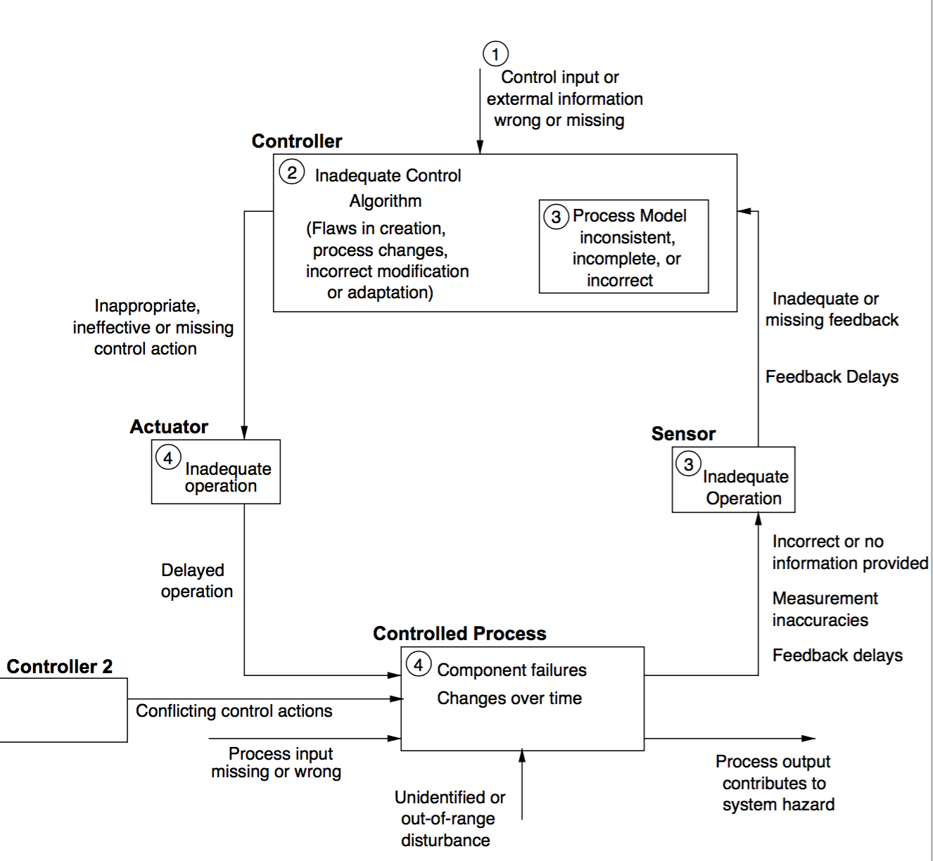

Slide 9
This diagram is an abstraction of the 10746 Computation View
PoC Process Boundary
Role: External System
OrderGovernanceToPoC
Pump To Ex.X
E.x
E[X]
Ex[X ]To Pump
PoCToOrderGovernance
System (ICS) Boundary
AppToEx.X
Ex[X]ToApp
Role: ICS
App Boundary
AppDisplayToOper
ICE Platform Boundary
Role: App
SUI App Display
OperToAppDisplay
AppToLogger
ICEDisplayToOper
M[XToApp]
AppToM[X]
OperToICEDisplay
Role: Data Logger
Role: Clinician (App Operator)
M[X]ToOper
PumpToApp
AppToPump
M.x
Role:
Device
Monitoring Devices
Role:
Device
OperToM[X]
PCA
Pump
PumpToOper
OperToPump
PumpToPatient
PatientToPump
PatientToM[X]
Role: Patient

Slide 10
Process Boundary
System (ICE) Boundary
App Boundary
n
SUI App Display
o
p
ICE Data Logger
Clinician (App Operator)
a
b
c
d
PCA
Pump
EtCO2
(capnography)
SPO2
(Pulse Ox)
RR
(capnography)
j
Device Suite
k
e
f
g
h
i
l
Patient
m

Slide 11
Process Boundary
System (ICE) Boundary
App Boundary
1
n
SUI App Display
o
p
5
ICE Data Logger
Clinician (App Operator)
a
b
c
d
2*
PCA
Pump
EtCO2
(capnography)
SPO2
(Pulse Ox)
RR
(capnography)
j
Device Suite
k
e
f
g
h
i
3
l
4
Patient
m

Slide 12
Control Loop 1: Clinician-AppControl
Clinician
Operator
Cognition
Operator
Actuation
Via SUI App Control Panel
Operator
Sensing
Via SUI App Display
Parameters (set points) for control algorithm
Algorithm and patient status via App Supervisor Display
Application
Control
Algorithm

Slide 13
Control Loop 2a: Clinician-Device-PCAPump
Clinician
Operator
Cognition
Operator
Actuation
Via Device Control Panel
Operator
Sensing
Via Device Display
Parameters for Infusion Prescription
Infusion Status,
Technical Alarms
Device Control

Slide 14
Control Loop 2b: Clinician-Device-Capnography
Clinician
Operator
Cognition
Operator
Actuation
Via Device Control Panel
Operator
Sensing
Via Device Display
Parameters for Limit Alarm Settings, Device Actuation
Device Control
Physiological Parameter Values,
Technical and Limit Alarm Notification

Slide 15
Control Loop 2c: Clinician-Device-PulseOximeter
Clinician
Operator
Cognition
Operator
Actuation
Via Device Control Panel
Operator
Sensing
Via Device Display
Parameters for Limit Alarm Settings, Device Actuation
Device Control
Physiological Parameter Values,
Technical and Limit Alarm Notification

Slide 16
Control Loop 3: Clinician-Patient
Clinician
Operator
Cognition
Operator
Actuation
Via Voice, Written Instructions
Operator
Sensing
Sight, Sound
Patient Instructions for PCA Pump operation and care giving procedures
Patient
Visual and verbal cues from patient regarding pain level and physical condition

Slide 17
Control Loop 4: Patient-BolusDose
Patient
Patient
Cognition
Sight/Sound recognition of device front panel cues and pain relief sensation
Patient
Actuation
Via Pump Bolus Button
Patient
Sensing
Sight, Sound
Button Press
PCA Pump
Audio/Visual cue of button press or infusion mode displayed on device front panel?

Slide 18
Control Loop 5: App-Device-Loop
App
Control
Algorithm
Pump KVO command
Pump Normal command
Physiological parameter readings,
Limit alarm notifications
Technical alarm notifications
PCA Pump Actuation
SpO2
Device
Sensing
EtCO2
Device
Sensing
RR
Device
Sensing
Flow of Opioid
Patient
Physiological condition

Slide 19
Control Loop 5: App-Device-Loop
(with classifications of communication links and component types)
[Link Role: Physiological Data,
Medium Risk Responsibility: Network Controller Provider,
Content Risk Responsibility: Data Stream Provider]
[Component Role: Controller – Interlock,
Risk Responsibility: App Vendor]
App
Control
Algorithm
[Link Role: Actuator Control,
Medium Risk Responsibility: Network Controller Provider,
Content Risk Responsibility: App provider]
Pump KVO command
Pump Normal command
(from general set of pump management and flow control commands)
Physiological parameter readings,
Limit alarm notifications
Technical alarm notifications
PCA Pump Actuation
[Component Role: Physical substance continuous flow actuation (infusion device),
Risk Responsibility: Pump Vendor]
SpO2
Device
Sensing
EtCO2
Device
Sensing
RR
Device
Sensing
[Component Role: Physiological Parameter Sensor (Transducer),
Risk Responsibility: Sensing Device Vendor]
Flow of Opioid
Patient
[Link Role: Physical substance continuous flow,
Medium Risk Responsibility: Pump Vendor,
Content Risk Responsibility: Pump Vendor]
Physiological condition
[Link Role: Physiological Parameter Sensor and associated communication,
Risk Responsibility: Sensing Device Vendor]

Slide 20
Control Loop: Order Definition
Physician
Cognition – Formation of Order
Mental Model of Patient’s Health
Recording and
Storage of Order
Recording of patient’s health in EMR, etc.
Transmission of Order to Care-giving Context
Order Execution Process
(Clinical Process?)
Outcomes of Order Execution reflected in patient’s actual health

Slide 21
Control Loop: Clinical Process
Output to Physician
Interpretation of Order by Clinicians
Mental Model of Patient’s Health and ICS PCA State
Actions to Configure ICS PCA, Patient
Output of ICS PCA
Direct Observations of Patient’s Health
ICS PCA State
Patient State

Slide 22
Configuration
<self test
fails>
<operator requests
operational mode>
<operator
requests
re-configuration>
Self Test
<self test
succeeds>
Operational

Slide 23
<self test
succeeds, fails>
Self Test
Configuration
<operator
requests
self-test>
<pre-conditions satisfied &
operator requests
operational mode>
<operator
requests
re-configuration>
Operational

Slide 24
Add communication from pump to app
4 variable model notes
Process Boundary
System (ICE) Boundary
App Boundary
n
SUI App Display
o
p
5
ICE Data Logger
Clinician (App Operator)
a
b
c
d
PCA
Pump
EtCO2
(capnography)
SPO2
(Pulse Ox)
RR
(capnography)
j
Device Suite
k
e
f
g
h
i
l
Patient
m

Slide 25
This diagram is an abstraction of the 10746 Computation View
PoC Process Boundary
Role: External System
OrderGovernanceToPoC
Pump To Ex.X
E.x
E[X]
Ex[X ]To Pump
PoCToOrderGovernance
System (ICS) Boundary
AppToEx.X
Ex[X]ToApp
Role: ICS
App Boundary
AppDisplayToOper
ICE Platform Boundary
Role: App
SUI App Display
OperToAppDisplay
AppToLogger
ICEDisplayToOper
M[XToApp]
AppToM[X]
OperToICEDisplay
Role: Data Logger
Role: Clinician (App Operator)
M[X]ToOper
PumpToApp
AppToPump
M.x
Role:
Device
Monitoring Devices
Role:
Device
OperToM[X]
PCA
Pump
PumpToOper
OperToPump
PumpToPatient
PatientToPump
PatientToM[X]
Role: Patient

Slide 26
Add communication from pump to app
4 variable model notes
Process Boundary
System (ICE) Boundary
App Boundary
n
SUI App Display
o
p
ICE Data Logger
A Cp_shutoff
C mp_spo2)
Command
Clinician (App Operator)
a
b
Latency,jitter
A Cp_shutoff
C mp_spo2)
PCA
Pump
EtCO2
(capnography)
SPO2
(Pulse Ox)
RR
(capnography)
j
Shutoff Delay.
Sensing delay, processing, resolution, etc.
Device Suite
k
Flow Rate
e
f
g
C (m_spo2)
System Monitored Variables
l
Patient
System Timing Requirements
m

Slide 27
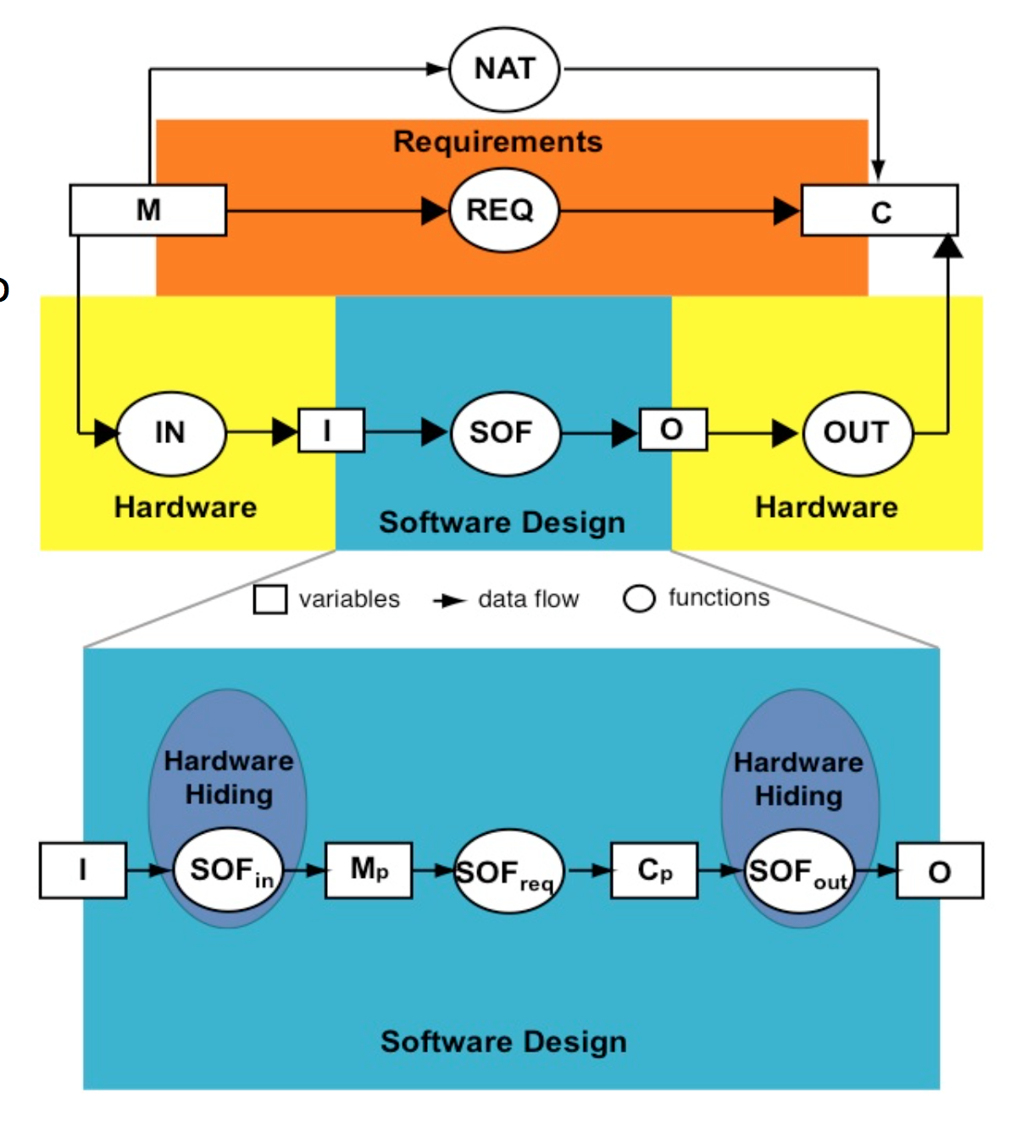
M to Mp – constraints on device, exposed as app requirements (formal specs) on device interface
Mp to Mp-a – communication across the network from device output to app input
Device Output

Slide 28
4 Variable Model Notes
Consider the control loop on the previous slides that involves physio parameter sensors, app-based “controller”, and PCA pump as actuator
For the system property capturing the “shutoff requirement”, introduce 4-var naming scheme for different system boundary inputs and outputs and component inputs/outputs for monitoring devices, app, and PCA
Imagine a simple shutoff condition based on some monitoring device parameter going out of range. Using the 4-variable paradigm, state the requirement.

